Slide 1


TASKIT A to-do list planner
Team Members:
Floria Pinto
Viola Noronha
Guide:
Dr. Prasad Padalkar

Slide 2

PROBLEM STATEMENT
To design a To-do list manager that makes one aware of how they spend time in the process of doing tasks and help them become productive. It tracks their activity to make them more efficient.

Slide 3
OUTLINE
Why should we use a to-do list app?
What is a To-do List? The definition is a simple one. It’s a list of tasks you need to complete or things that you want to do.
Having a list of everything you need to do written down in one place means you shouldn’t forget anything important. By prioritizing the tasks in the list you plan the order in which you’re going to do them and can quickly see what needs your immediate attention and what tasks you can leave until a little later
Benefits of using TaskIt.
Increases productivity
Helps with motivation
Simplify the workflow
Organization of a proper work with accurate planning.

Slide 4
SCOPE
Task reminders - Have your device remind you every few minutes to ensure you get the message.
Time Tracking - Keep track of both the estimated and actual length of tasks
Calendar Integration - You can view your tasks on your device's calendar, allowing you to see both calendar events and to-do items on one screen.
Simple UI - Simple to use. Simple user interface. Too many features just clutter things up.
Quick and Easy to use - Creates tasks fast and easily.
Prioritization - It is important to be able to separate important tasks from the lesser ones

Slide 5
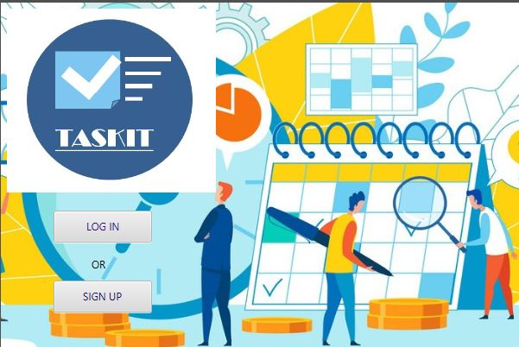
PROTOTYPE- Log In page

Slide 6
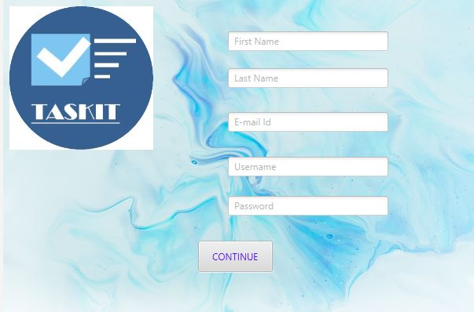
PROTOTYPE- Details page

Slide 7
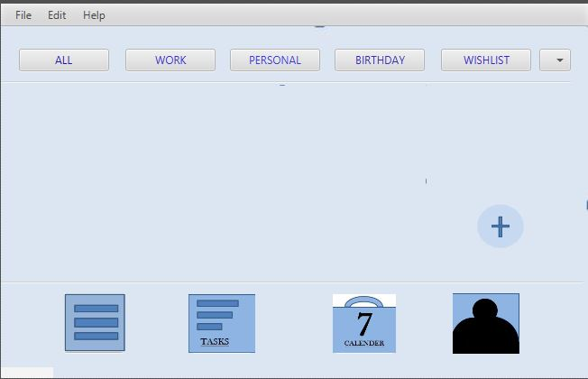
PROTOTYPE- Main Window

Slide 8
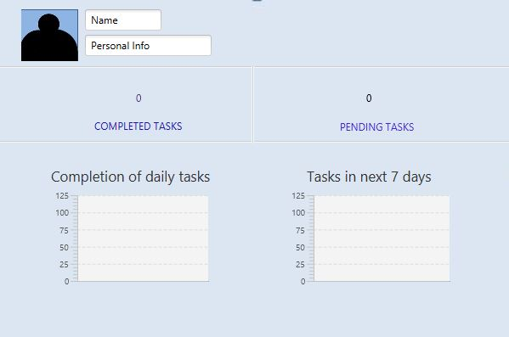
PROTOTYPE- Profile Page

Slide 9
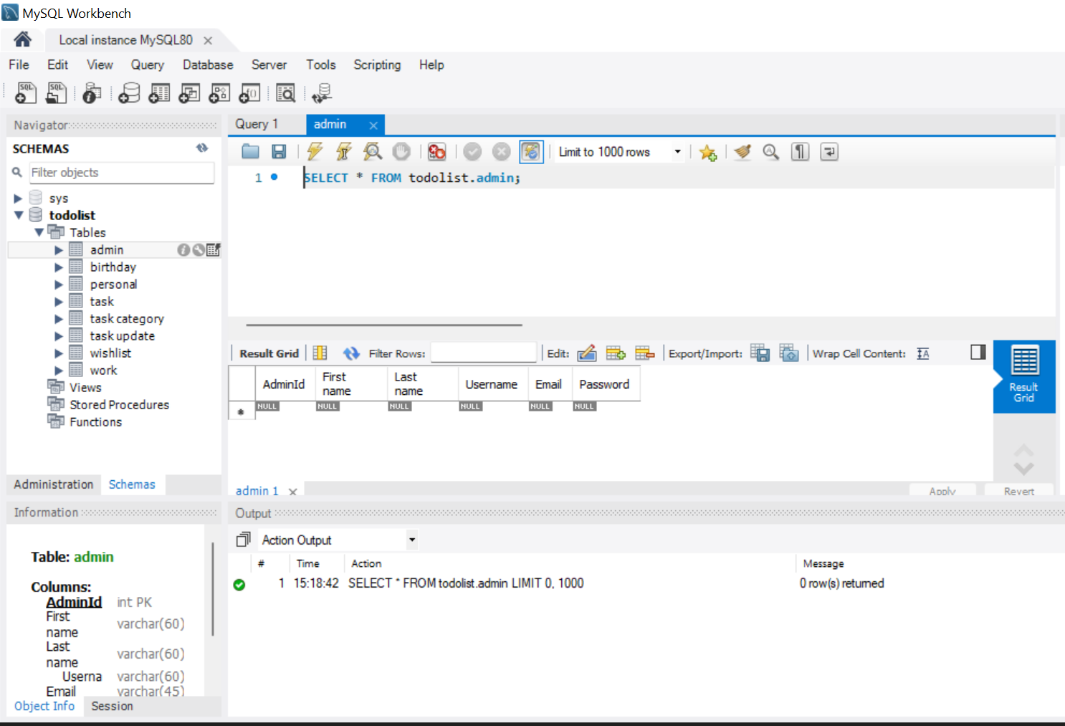
DATABASE DESIGN- Sql File

Slide 10
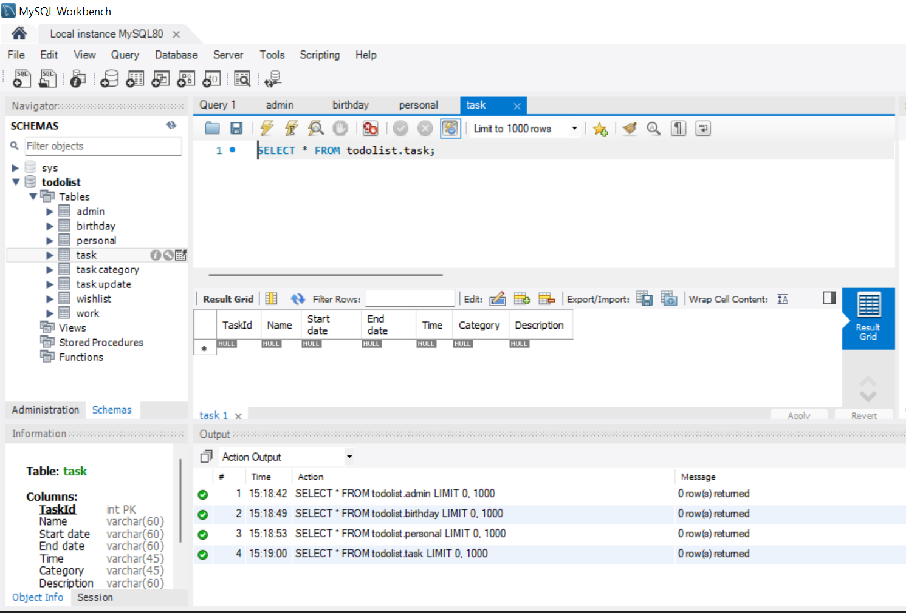
DATABASE DESIGN-Sql File

Slide 11
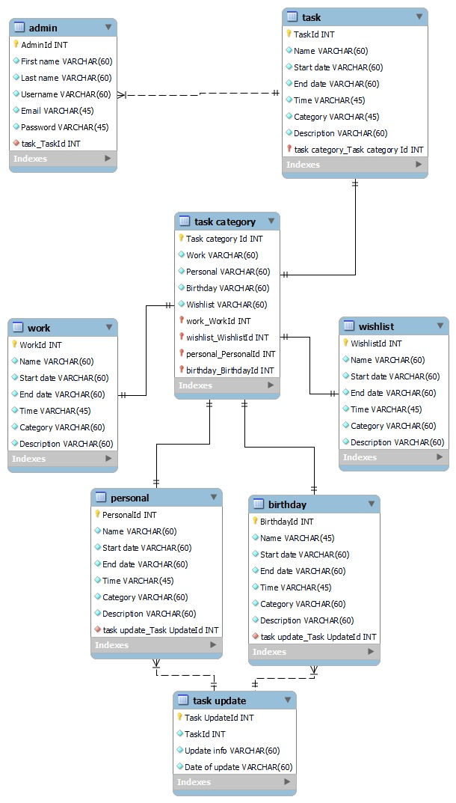
ER DIAGRAM

Slide 12
ROLES AND RESPONSIBILITIES
Floria Pinto-
UI design
Logo design
Slides
Viola Noronha-
Research
DBMS
Slides

Slide 13
GITHUB LINK
https://github.com/violanoronha/Mini-Project--To-do-list.git
https://github.com/floria-pinto/Mini-Project-To-do-list.git

Slide 14
THANK YOU

